Slide 1

CI & slide design

Slide 2
Orange

Slide 3



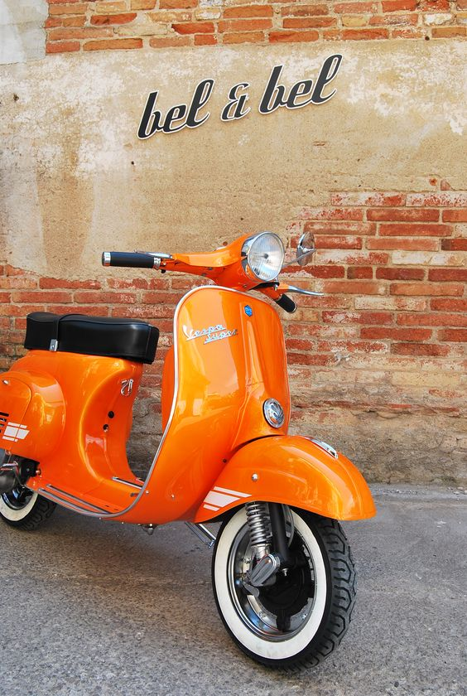

Slide 4
Teal

Slide 5



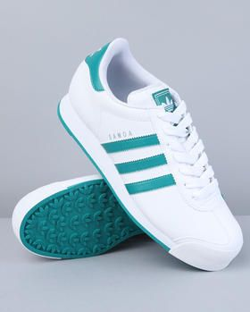


Slide 6
Black

Slide 7





Slide 8
White

Slide 9





Slide 10
Mixed

Slide 11

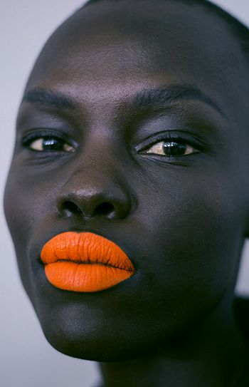
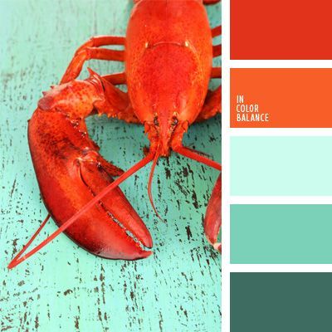
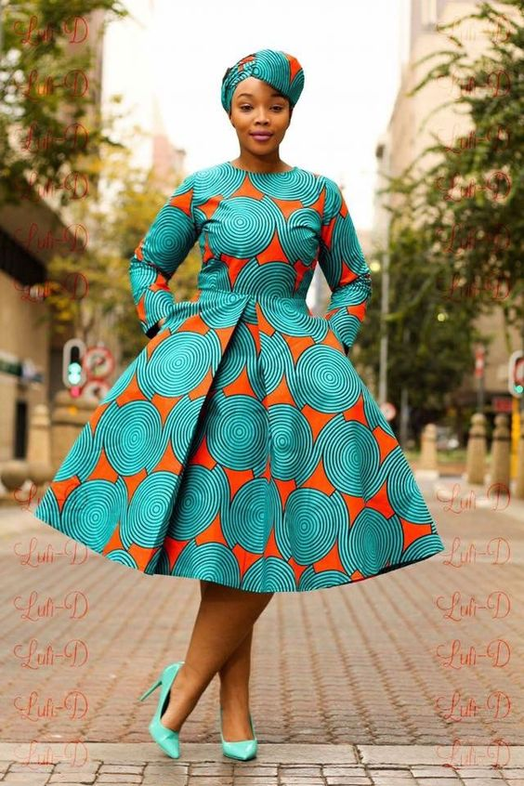


Slide 12





Slide 13
Key colours

Slide 14
Orange:
R: 243
G:75
B: 41
Teal:
R: 67
G:180
B: 181

Slide 15
The fonts

Slide 16

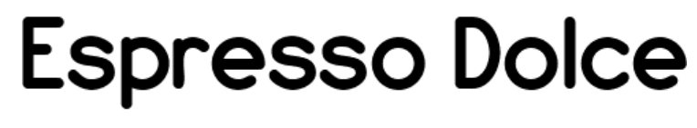
Body copy: Century Gothic in grey or white
Header copy On white, grey, teal
or orange
Logo font
Knowledge is your Superpower.

Slide 17
The logos

Slide 18


Slide 19
Photography

Slide 20


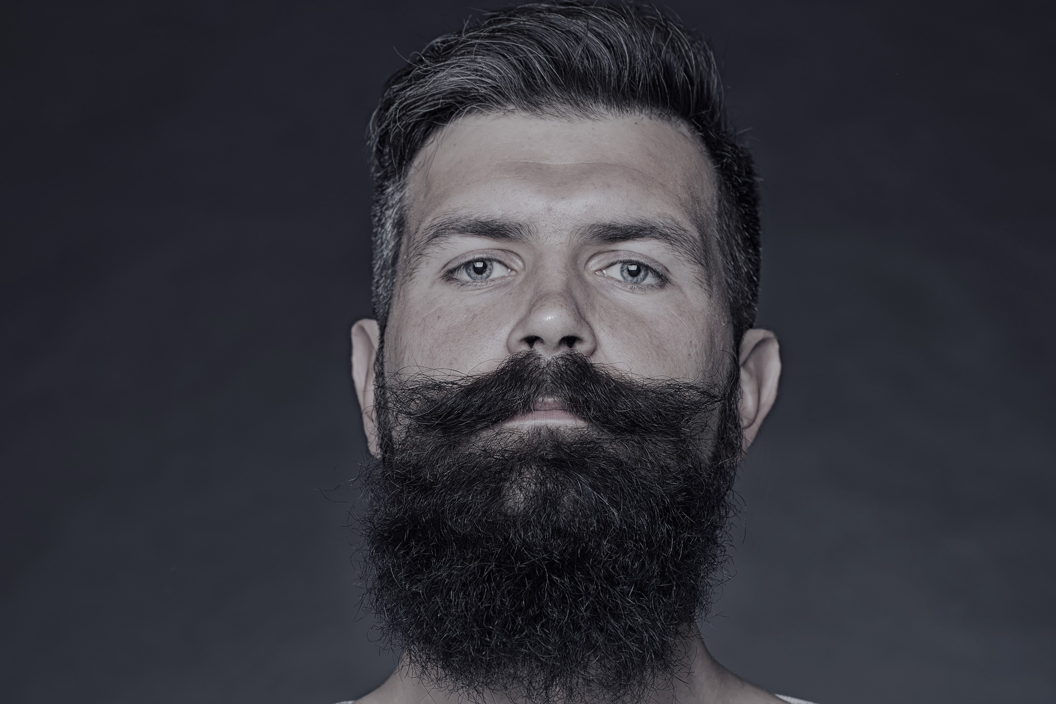


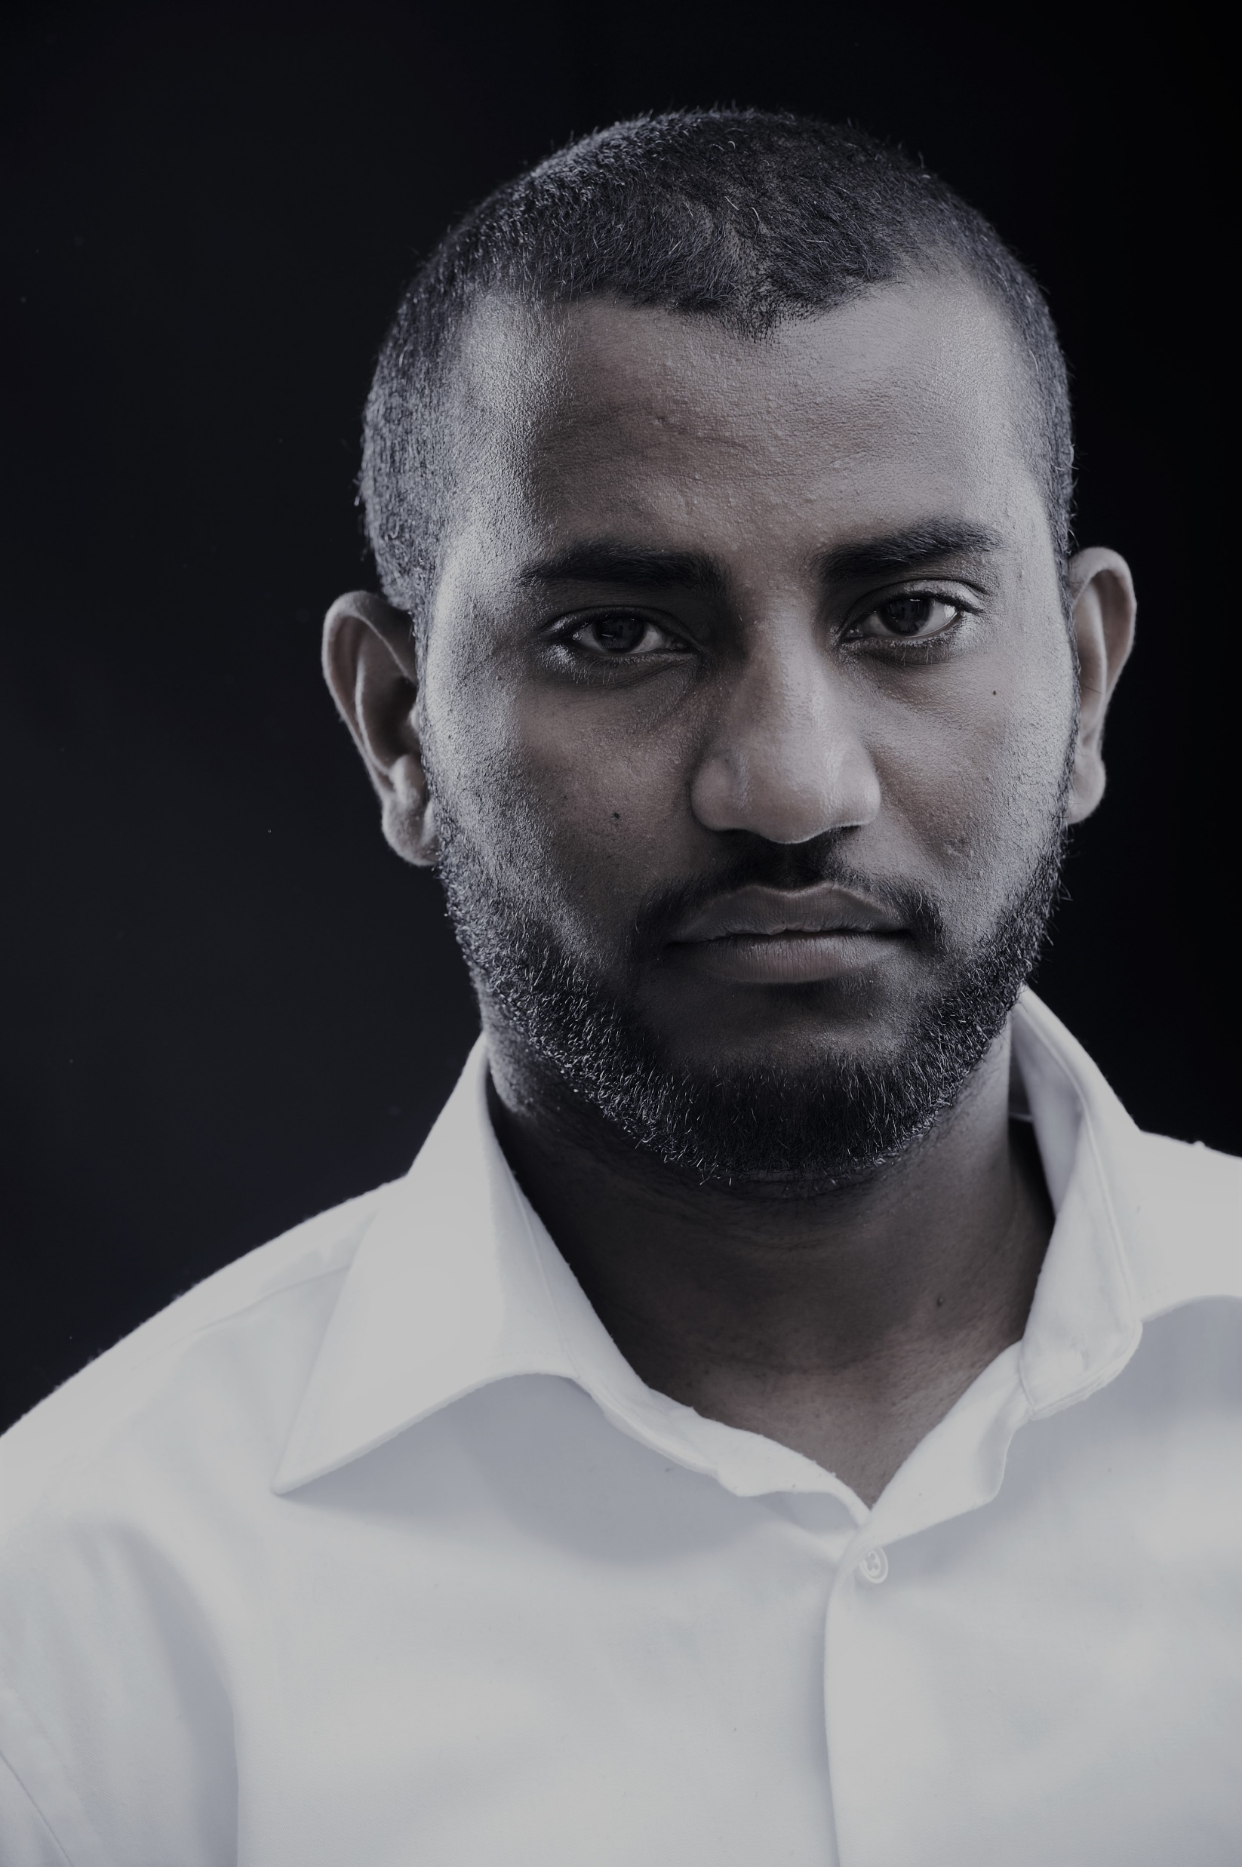

Slide 21

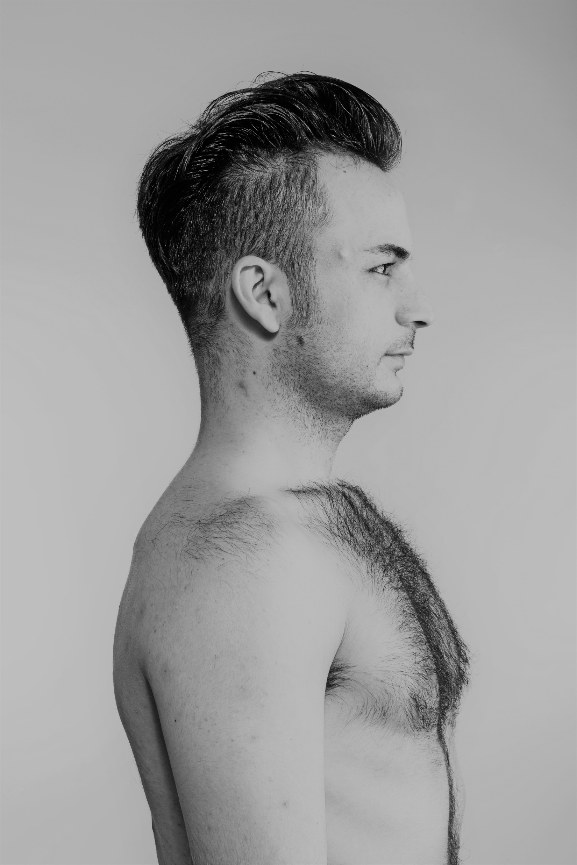



Slide 22
Graphics

Slide 23








Slide 24
Patterns & wallpapers

Slide 25











Slide 26
The look

Slide 28


Hi Carmen, the quality here is not great. Perhaps just replace with the real thing ☺

Slide 29








Slide 30





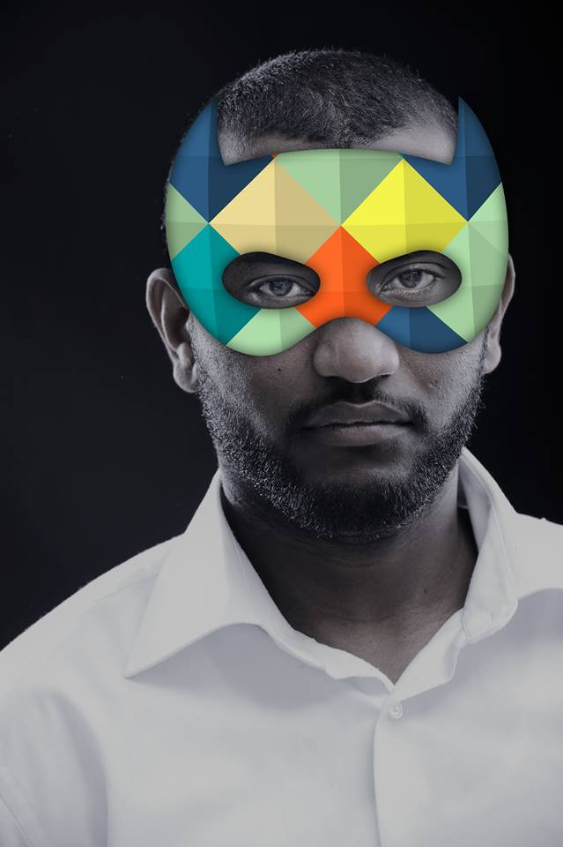






Slide 31
Presentation slides

Slide 32
Opening & closing slides
3 options provided

Slide 33
Hello

Slide 34
Thanks

Slide 35
Hello

Slide 36
Thanks

Slide 37
Hello

Slide 38
Thanks

Slide 39
Primary
breaker slides

Slide 40
Heading
here

Slide 41
Heading
here

Slide 42
Heading
here

Slide 43
Heading
here

Slide 44
Heading
here

Slide 45
Content
slides

Slide 46
Heading goes here
Copy goes here
Copy goes here

Slide 49
Heading goes here
Copy goes here
Copy goes here

Slide 55
Heading goes here
Copy goes here
Copy goes here

Slide 61
Heading goes here
Copy goes here - Ideal for a powerful quote

Slide 62
Heading goes here
Copy goes here - Ideal for a powerful quote

Slide 63
Heading goes here
Copy goes here - Ideal for a powerful quote

Slide 64
Thanks

Slide 65
“Powerful punch!”
An African inspired Educational Marketing Services
We design and build Future-Fit Businesses for Industry 4.0

Slide 66
You don’t need an IT degree to innovate, you need an understanding of the framework
Boo-Yah! gives the strategic skills and new technologies, for any business
Without making tech intimidating
A road map and tactical applications to thrive
Tools & know-how for digital transformation
mCordis, a powerful partnership crafted around African markets
KAPOW! Knowledge is
your Superpower!

Slide 67
What are the new skills you need?
How can you learn them in a way that works for your business?
What are the new skills you need?
How can you turn that new knowledge into a competitive advantage?

Slide 68
Future-fit
your business
Educational Marketing Services Company
with a powerful punch

